Slide 1
Sales and Budget Analysis (Story board)
File created on: 6/20/2024 7:50:34 AM

Slide 2
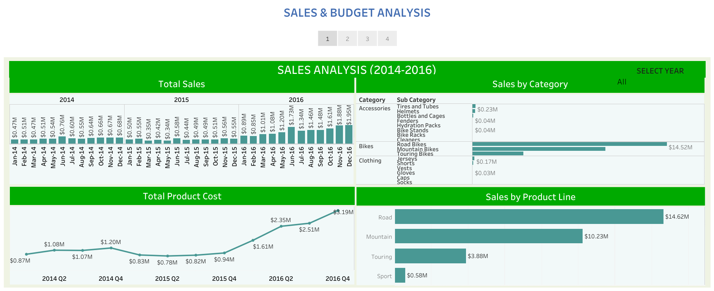

Slide 3
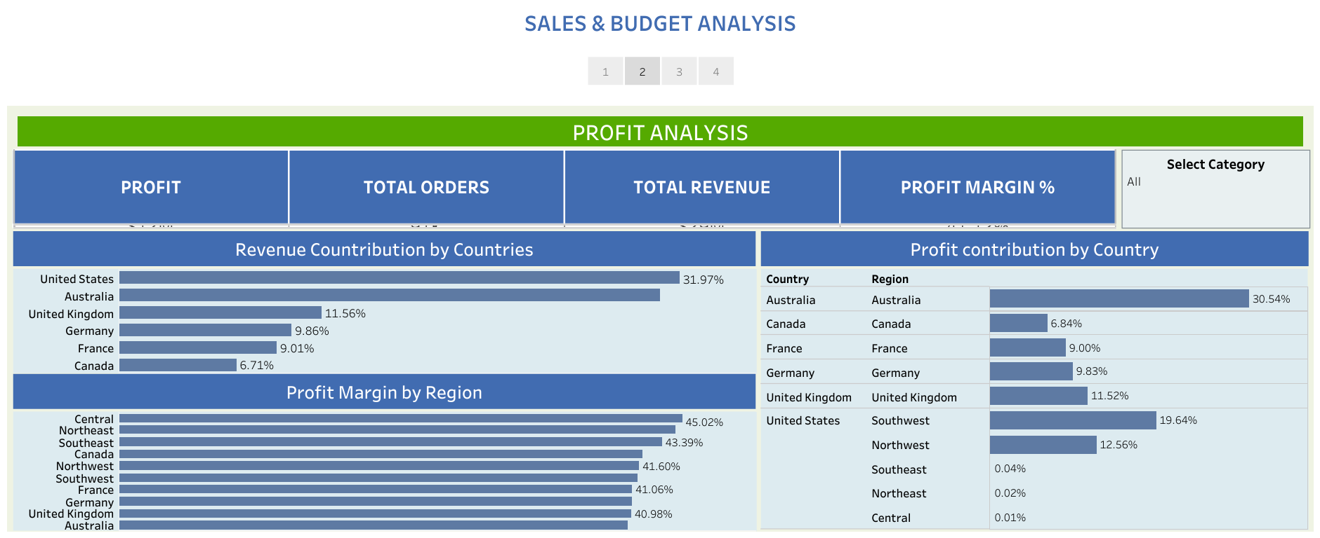

Slide 4
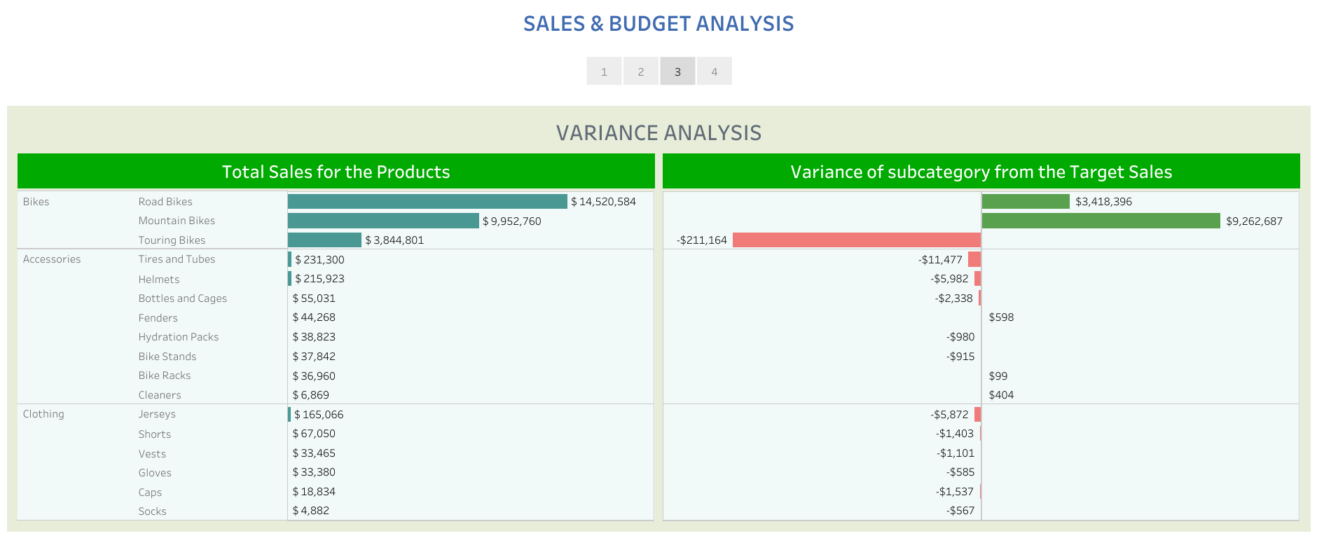

Slide 5
